Slide 1


Heart Disease Prediction Data 606: Capstone in Data Science Professor: Chaojie Wang
Presented by Pavani Madu

Slide 2
Introduction
Heart Disease is a deadly disease that claims millions of lives each year, and early detection is critical for successful treatment.
In this project, I aim to develop a machine learning model that can accurately detect heart disease considering the columns in dataset.
By leveraging advanced techniques in deep learning, I hope to create a tool that can help doctors make more informed decisions and improve patient outcomes.

Slide 3


Importance
Heart disease is a critical health concern globally, representing a leading cause of morbidity and mortality.
According to the World Health Organization (WHO), cardiovascular diseases account for nearly 18 million deaths annually, making it the leading cause of death worldwide.
It is costly and difficult to perform heart disease tests to all the people.
So a model which can detect heart disease just by inputting few identifiable things would reduce the cost a lot by reducing the number of patients to test.

Slide 4
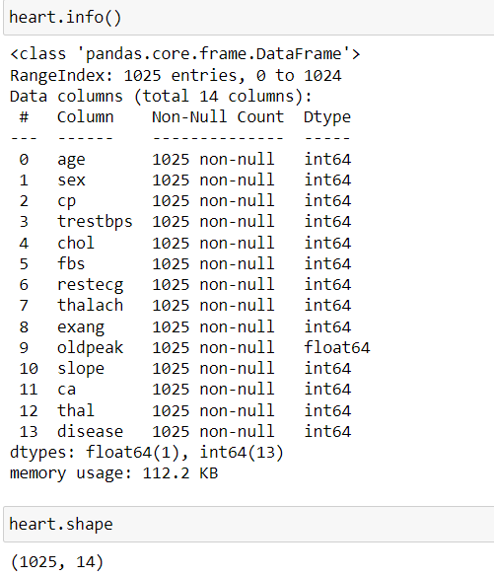
Dataset
a
I collected the data from the below link
https://www.kaggle.com/code/talhabarkaatahmad/heartattack-predictions-and-data-analysis/input
The dataset has 1025 units of analysis
Each record represents a patient record with various attributes

Slide 5
Variables or measures
oldpeak: ST depression induced by exercise relative to rest
slope: the slope of the peak exercise ST segment (downsloping/flat/upsloping)
ca: number of major vessels (0-3) colored by fluoroscopy
thal: 0 = normal; 1 = fixed defect; 2 = reversable defect
disease: yes or no (1/0)
Below are the variables I am considering for analysis
Age
Sex
Cp – Chest Pain Type
trestbps - resting blood pressure
chol
Fbs (fasting blood sugar)
restecg (resting electrocardiographic results)
thalach: maximum heart rate achieved
exang: exercise-induced angina

Slide 6
Data Pre-Processing
Find out the missing values in the dataset
No potential missing values found in the dataset
The data is pretty clean and no further pre-processing required

Slide 7
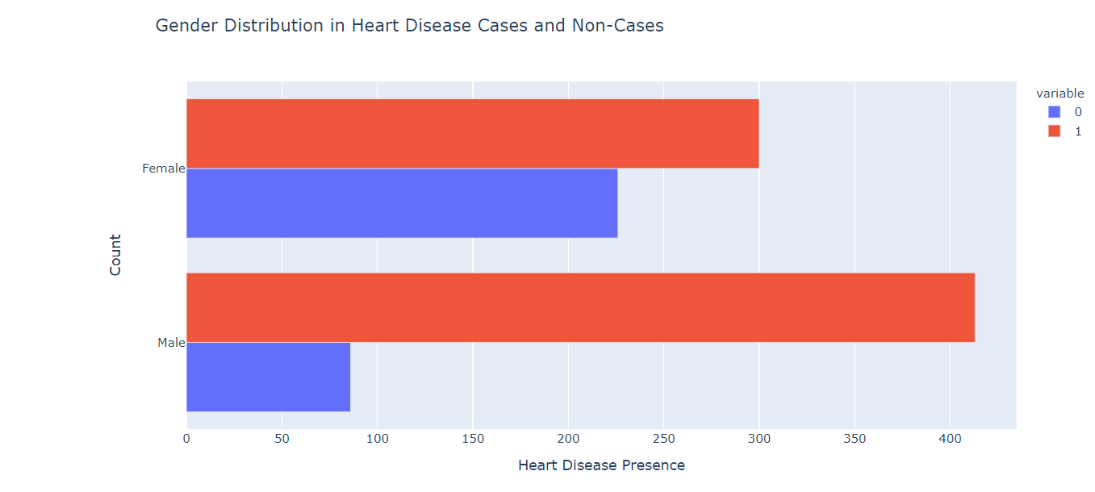
Exploratory Data analysis
Distribution of Patient Gender
Males are more likely to have heart disease than females. This suggests that gender may be a significant risk factor for heart disease.

Slide 8
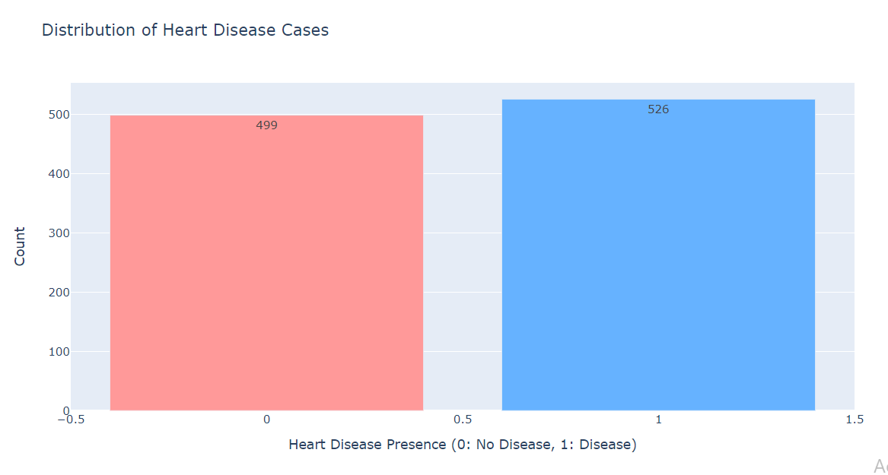
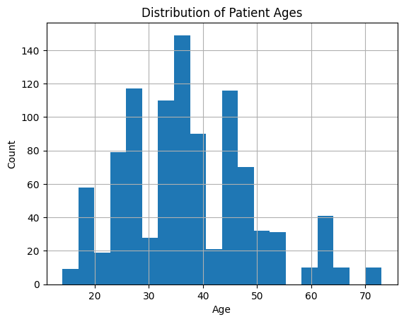
Exploratory Data analysis
Distribution of Heart Disease Presence

Slide 9
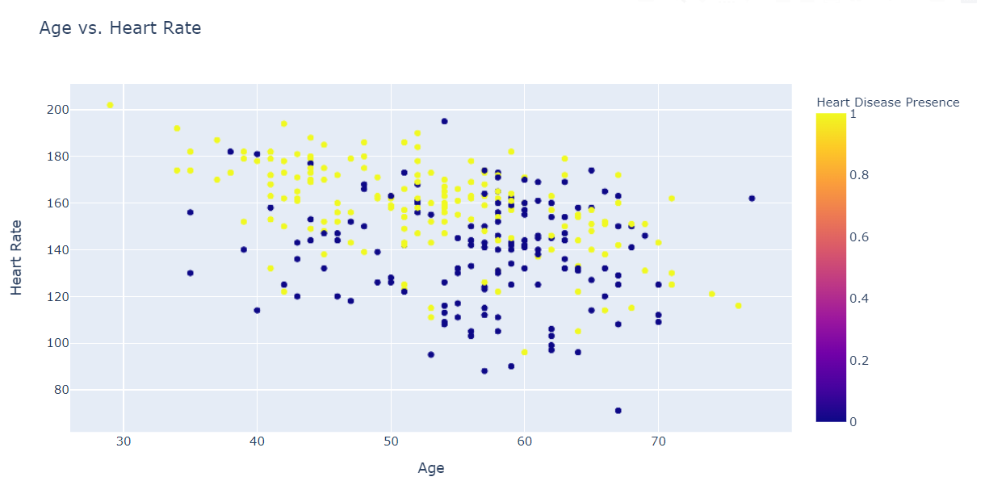
Exploratory Data analysis
Scatter plot of age vs Heart rate

Slide 10
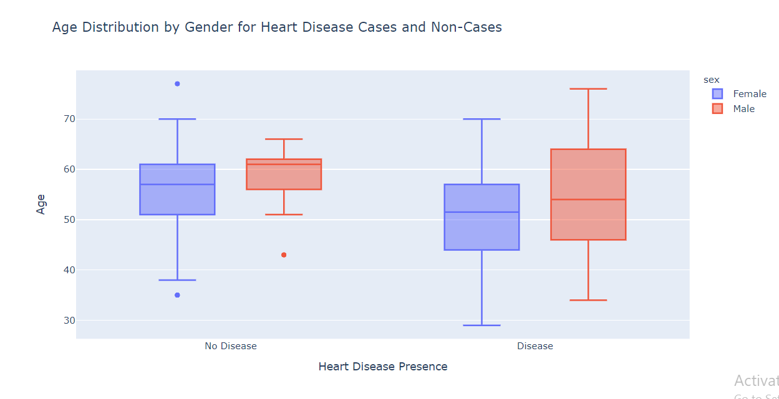
Exploratory Data analysis
Age Distribution by Gender

Slide 11
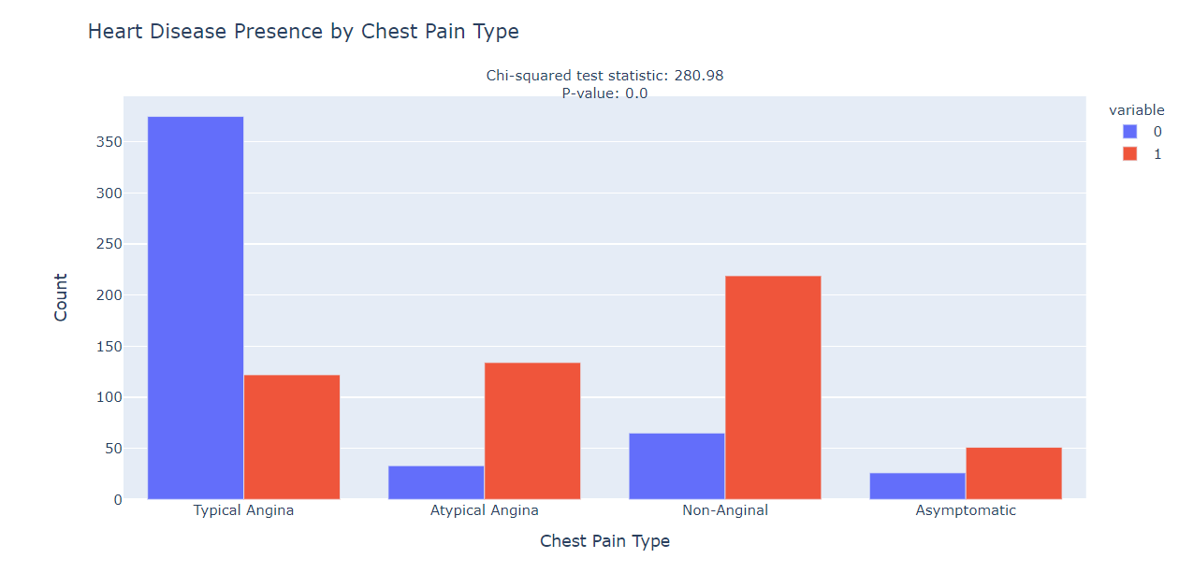
Exploratory Data analysis
Distribution by Chest pain type

Slide 12
Models
Models are trained and analysed
K- nearest neighbours
Random Forest Classifier
Logistic regression
The confusion matrix is drawn for analysis

Slide 13
Model Score
Split data in respective train and test variables
Train : 80% Test: 20%
Created a function fit_and_score to evaluate scores of each model
{'KNN': 0.7463414634146341, 'RFC': 1.0, 'LR': 0.8634146341463415}
RFC shows 100% which is not acceptable

Slide 14
Improving Model
Methods used
Hyperparameter Tuning
Random Search CV
Grid Search CV

Slide 15
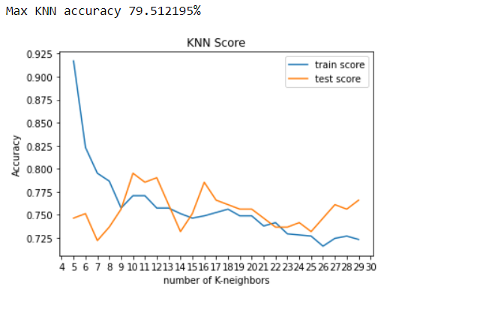
Model - K- nearest neighbours
KNN has been performed with different values for k and the respective accuracy values are plotted as below

Slide 16
Random Search CV
This is a method for hyperparameter tuning that performs a randomized search over a specified parameter grid. It randomly samples a set of hyperparameter combinations from predefined distributions.
In this case, cv is set to 5-fold cross-validation, meaning the dataset is split into 5 parts, and the model is trained and evaluated 5 times, each time using a different part as the test set.

Slide 17
Grid Search CV
This is another method for hyperparameter tuning that performs an exhaustive search over a specified parameter grid. Unlike RandomizedSearchCV, which randomly samples a set of hyperparameter combinations, GridSearchCV considers all possible combinations in the specified parameter grid.

Slide 18
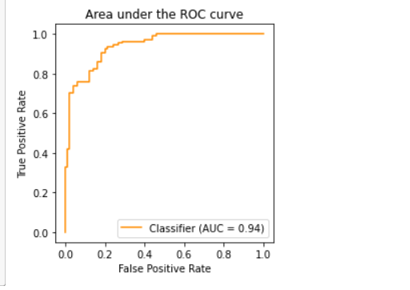
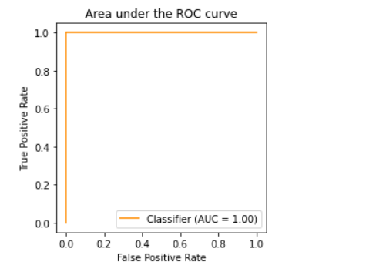
AUC - ROC Curve
Logistic Regression Random Forest Classifier

Slide 19
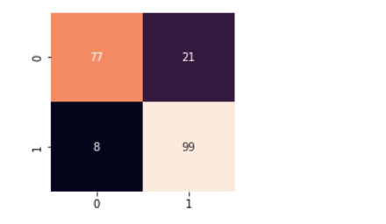
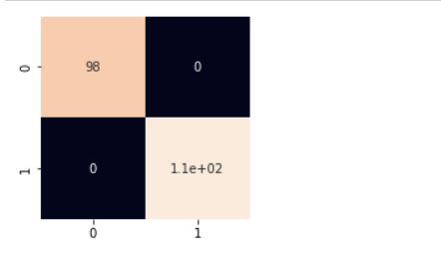
Confusion Matrix
Logistic Regression Random Forest Classifier

Slide 20
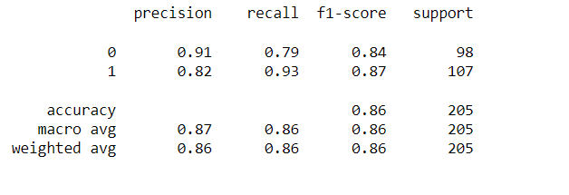
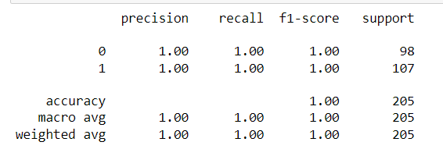
Results
Logistic Regression
Random Forest Classifier

Slide 21
Decision
1. The logistic regression model achieved AUC score of 94% indicating a good level on predictive performance
2. Random forest algorithm achieved 100% accuracy which seems to be overfitting the model
3. Different factors like age, gender, chest pain type, maximum heart rate achieved have a significant impact on the heart disease
4. As the RFC model is overfitting in this case, I have chosen logistic regression to be the best model to predict heart disease presence in the patients.

Slide 22
Heart Disease Prediction App
Used Streamlit to develop the heart disease prediction app
When user interacts with the app and input different parameters of a patient, the prediction results are displayed.

Slide 23
Conclusion
In conclusion, applying automated models to detect heart disease will reduce the efforts of doctors very much and thus the doctors will be able to concentrate on treating the people who require it.
The availability and calibre of the data, as well as the thorough selection and fine-tuning of machine learning algorithms, are what determine whether such a project is successful. A heart disease prediction model could potentially save lives by detecting the disease sooner and enhancing treatment outcomes with the correct tools and knowledge.

Slide 24
Thank You

